Slide 1
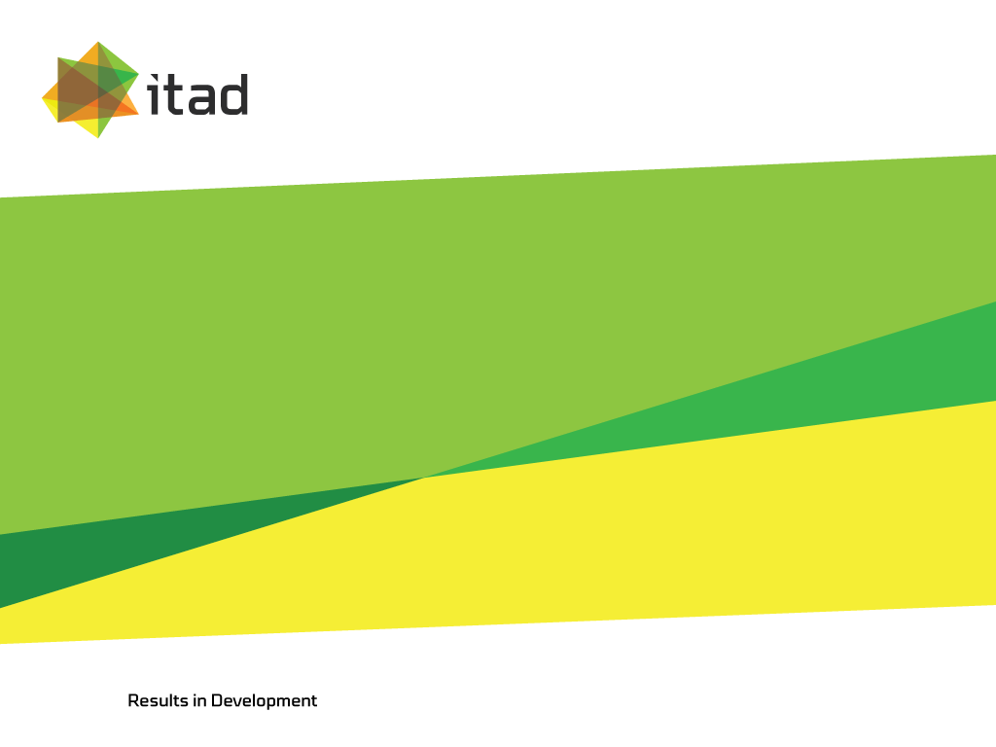
Testing the waters
How to strengthen ICTs for monitoring to improve the sustainability of water services?
8 September 2015
Katharina Welle, Itad Ltd

Slide 2
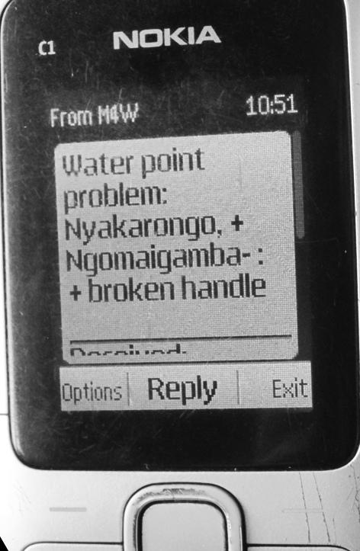
Background to the study
This is a small research project under the Making All Voices Count initiative, funded by HIVOS and managed by the Institute of Development Studies.
The study objective is to better understand the factors that facilitate and inhibit the success of ICT-based reporting mechanisms that aim to improve rural water supply sustainability.

Slide 3
Which initiatives did we compare?
NGO-led reporting
Monitoring for budgeting and planning
Rural
Urban
Re-imagining Reporting,
Bolivia
Maji Voice, Kenya
Next Drop, India
SIBS, Timor Leste
Human Sensor Web, Zanzibar
Government / service provider-led reporting
Mobiles4Water, Uganda
Maji Matone, Tanzania
Smart Handpumps, Kenya
Reporting through crowd-sourcing
Automated reports
Notes:
M4W: This initiative aims to improve the functionality of rural drinking water sources by reducing downtime through use of timely, actionable information: a user with a broken pump sends a text message to the system, which sends a message to a mechanic to go to the site.
Maji Voice: This Maji Voice system allows consumers to easily report and track complaints, query bills and receive updates on their mobile phones in Nairobi, Nakuru, and two more towns in Kenya. It provides utility staff with a task-management software to process and analyse incoming complaints, and compiles automatic statistics for the regulatory authority.
Maji Matone: Maji Matone was designed to encourage citizens to report water point functionality in their areas. It aimed to give citizens in rural Tanzania a new channel to report on broken down water points through the use of mobile phone technology and to use local media to amplify these reports and put pressure on local government departments to resolve the reported problems.
Next Drop: Next Drop’s (4 cities) real-time data and messaging system uses SMS to inform water users who have subscribed to the service about when they will be receiving water, when there is a delay, when pipe damage is likely to affect them, and when someone in the community has water updates to share.
SIBS: SIBS is a water supply monitoring system led by the national government of Timor Leste in which data on water point coverage and functionality is collected by district government staff every three months for budgeting and planning purposes.
RIR: is a platform to which monitoring data is uploaded. It aims to provide an interactive, visually compelling way for donors, stakeholders and the public to understand Water for People’s progress and outcomes while also allowing for analysis and review of initiatives for programmatic improvements, including annual reflection meetings to encourage partners to use the monitoring data to plan for the year ahead.
HSW: The initiative aimed to collect data on water supply functionality and quality in Zanzibar Town. The reporting was based on crowd-sourcing with users encouraged to send a text message to the water authority if they experienced water shortages. The data is meant to be used by communities to report about lack of water at kiosks and poor water quality as well as to advocate for better water services.
SHs: Smart Handpumps, an initiative by the Department of Geography and Environment at the University of Oxford, is based on realtime monitoring of handpump downtime. A ‘smart handpump’ has a GSM transmitter securely fitted inside the handle of the pump. The transmitter automatically sends data on handpump use via text message over the mobile phone network.
Differences:
Urban – rural
Aim: for budgeting and planning versus water point repairs
Who reports: crowd-sourcing versus government / service provider / NGO led
How data is reported: via automated systems or requiring human interaction (someone manually sending a report

Slide 4
What is Qualitative Comparative Analysis (QCA)?
QCA is a methodology that helps identifying the most influential factors in achieving a specific outcome among a number of cases.
The key steps are:
Identifying the outcome
Identifying the conditions influential for achieving the outcome
Collecting data on all conditions and outcomes among all cases
Scoring the achievement of conditions and outcomes
Through QCA analysis (including software) identifying the most pertinent patterns among the cases that lead to outcome achievement and those that are not
Notes:
We only had 8 case studies, but QCA works well for a medium number of cases (there is no specific limitation in the literature)

Slide 5
Outcomes & conditions identified
Outcome 1: successful ICT-based reporting
Conditions: (1) reliable GSM reception, (2) ICT devices can be charged, (3) users have access to the ICT device, (4) is the data reported periodically or related to specific incidents?, (5) does the report require human interaction or is it automatic?, (6) who reports?, (7) people reporting prefer the ICT mechanism over alternatives, (8) the costs of reporting are not a problem, (9) users have sufficient information and knowledge to report
Outcome 2: successful ICT report processing
Conditions: (1) reliable GSM reception, (2) computers and electricity are available, (3) access to the necessary software, (4) access to back-up IT support, (5) sufficient human resources and knowledge to process reports, (6) clarity on procedures for following up on reports, (7) operational costs are largely met by the government / service provider
Outcome 3: successful water point repairs
Conditions: (1) sufficient funds for carrying out repairs, (2) operation and maintenance responsibilities are clear to all parties, (3) spare parts are available, (4) a mechanic is available, (5) accountability mechanisms are in place to ensure ICT reports are acted on, (6) the initiative supports existing sector responsibilities for operation and maintenance

Slide 6
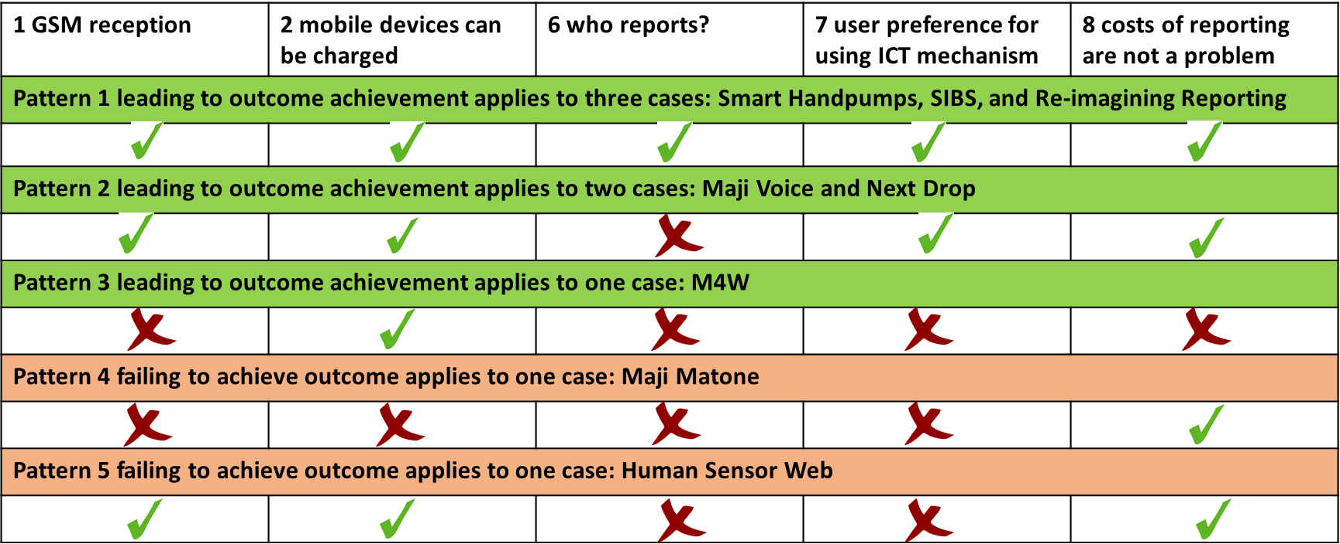
QCA findings for successful ICT-based reporting
Outcome 1: successful ICT-based reporting
Conditions: (1) reliable GSM reception, (2) ICT devices can be charged, (3) users have access to the ICT device, (4) is the data reported periodically or related to specific incidents?, (5) does the report require human interaction or is it automatic?, (6) who reports?, (7) people reporting prefer the ICT mechanism over alternatives, (8) the costs of reporting are not a problem, (9) users have sufficient information and knowledge to report
Notes:
Interpretation of QCA findings:
Pattern 1 and 2: the only difference is that reporting is provider led in the case of Maji voice and Next Drop
Pattern 3, also successful: relatively surprising as many of the conditions were not met. Based on a further, more in-depth case study, we can now see that the reporting was not as successful as it seemed from the M4W documentation at first sight. Many of the messages sent were sent as part of the baseline, so if we had an opportunity to re-analyse the data, we might actually to come the conclusion that M4W was not successful in reporting.
Pattern 4: in the urban area, charging phones or GSM reception was not a problem, but rather some factors that did not feature in the QCA analysis: lack of trust in the local water authority and operator at the time, and an issue with the design: users were supposed to text when there was no water at kiosks, but they did not see this as necessary because they were used to service interruptions at the time.
Overall: half of the successful cases were linked to government / service provider led reporting or where the initiative was housed with the provider. This could be seen as an active engagement to improve trust and services for citizens – potentially more successful than initiatives that rely on crowd-sourcing and on putting pressure onto providers from outside agents?

Slide 7
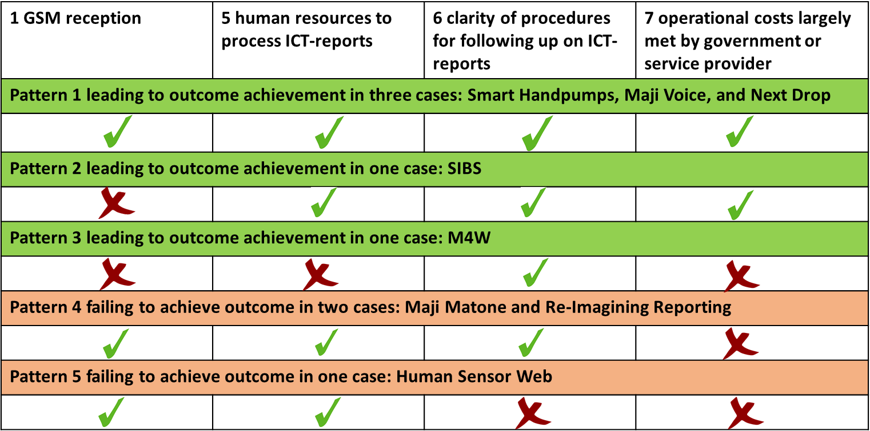
QCA findings for successful ICT report processing
Outcome 2: successful ICT report processing
Conditions: (1) reliable GSM reception, (2) computers and electricity are available, (3) access to the necessary software, (4) access to back-up IT support, (5) sufficient human resources and knowledge to process reports, (6) clarity on procedures for following up on reports, (7) operational costs are largely met by the government / service provider
Notes:
Pattern 1 and 2: all factors fulfilled – GSM reception not important for SIBS because data could be uploaded when the extension workers are back in the office.
Pattern 3: M4W – again a slight outlier – probably successful because of external support provided by Triple-S / project staff.
Pattern 4 and 5: here, you can clearly see that the lack of operational costs covered by the government or service provider play a key role in the lack of success for HSW, MM, and RiR. => you could argue that this indirectly represents the ownership of the government / service provider for the initiative. This confirms findings from the literature, that the initiative needs to be well anchored with the local government or service provider to be successful.

Slide 8
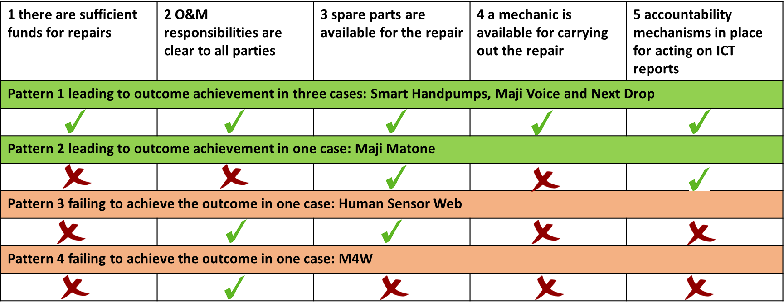
QCA findings for successful water supply repairs
Outcome 3: successful water point repairs
Conditions: (1) sufficient funds for carrying out repairs, (2) operation and maintenance responsibilities are clear to all parties, (3) spare parts are available, (4) a mechanic is available, (5) accountability mechanisms are in place to ensure ICT reports are acted on, (6) the initiative supports existing sector responsibilities for operation and maintenance
Notes:
Successful Pattern 1: no surprises – all conditions are met.
Successful pattern 2: Maji Matone is a an outlier – this is related to the difficulty in judging a condition as either successful or non-successful, which proved difficult e.g. on funds available for repairs – this could be available in some cases, but not in others, and there is no black and white answer for the whole district. The fact that the initiative was successful in carrying out repairs based on reports may be related to increased follow up by district water engineers where messages were received about a breakdown.
Pattern 4: M4W – useful to compare that to pattern 1 where a maintenance model was part of the initiatives.
Pattern 3: there was also no direct accountability mechanism to follow up on ICT reports by the initiative. The build up of political pressure did not happen as assumed

Slide 9
Patterns based on scoring of outcomes
 | Smart Handpumps | M4W | Maji Matone | Maji Voice | SIBS | RiR | Next Drop | Human Sensor Web
Outcome 1: Successful ICT-reporting | 1 | 1 | 0 | 1 | 1 | 1 | 1 | 0
Outcome 2: Successful ICT report processing | 1 | 1 | 0 | 1 | 1 | 0 | 1 | 0
Outcome 3: Successful service improvements | 1 | 0 | 1 | 1 | 0 | 1 | 1 | 0

Slide 10
Overall conclusions
ICT reporting is more likely to be successful if service or government provider-led compared to crowd-sourcing
ICT report processing is more likely to be successful if its costs are largely covered by the government or service provider
Water service repairs are more likely to occur if the ICT initiative has an in-built maintenance model

Slide 11
Thank you for listening
Any Questions?

