Slide 1
SIBS – rural water supply monitoring in Timor Leste
Joseph Pearce
27 Oct 2015

Slide 2
Making All Voices Count Phase II
Aim to identify factors which facilitate or inhibit success of rural water supply monitoring systems
Review of 50 ICT-based monitoring initiatives in WASH sector
Eight cases identified for greater investigation
Parameters of success defined for reporting, processing and use
Remote interviews conducted
SIBS scored as highly successful for reporting and processing of data, but unsuccessful for using data

Slide 3
Making All Voices Count Phase III
Aim of SIBS is to provide regular, reliable information on water, sanitation and hygiene to decision-makers for improvement of services and tracking targets
Further investigation to learn
Aspects which support successful reporting and processing
How reporting continued in some areas and not others
Representation of communities in data collection
Barriers to using data

Slide 4
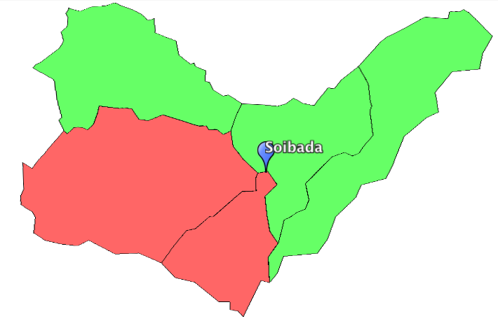
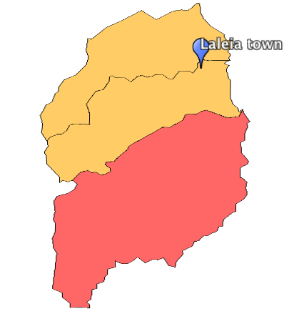
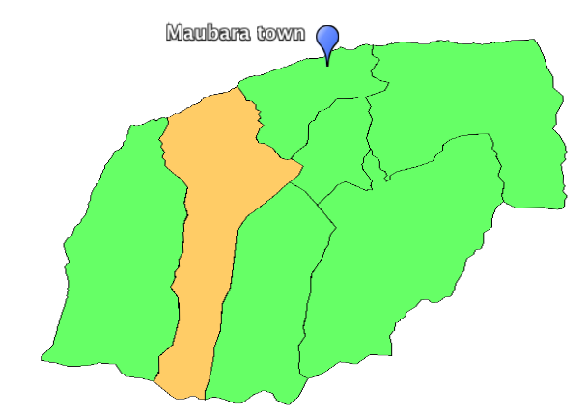
Three sub-districts investigated
Analysis of reporting instances to identify three sub districts for interviews
Green – Suco updated past 12 months
Yellow – Suco updated past 24 months
Red – Suco not updated in past 24 months
Blue icon is the district town
Discussions with government staff & community
National gov depts & development partners
Local gov data collectors, dead of district department and district technical officer
Community groups and their representatives

Slide 5
Community profile
Data is collected for Community Profile and not water point level
There is no geo-referenced data collected
Water
Humber of HH
Time taken to collect water
Adequate water supply
Water system functioning status
Water quality & level of source protection
System management
Number of women in responsible roles
Sanitation & hygiene
Access to improved latrine
Access to unimproved latrine
Access to shared latrine
Access to handwashing facility with soap
Open defecation free status

Slide 6
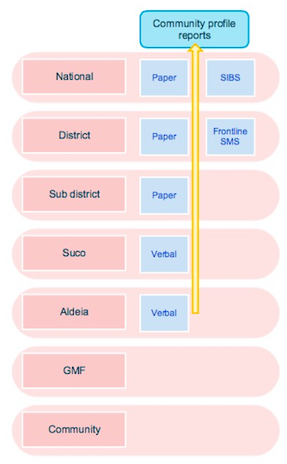
Data flow up
Each district has several data collectors
Visit each Aldeia Chief every 3 months for community data
Complete format with 11 indicators (water, sanitation, hygiene)
Paper forms completed in field and SMS sent from district
Limited checks on data at district
Information received by database administrator at national level

Slide 7
Key findings related to regular data reporting
Data collection role is permanent, institutionalised, and sufficiently resourced (motorbike, fuel, phone, credit).
Few phones still reporting – 33 out of 88 – due to loss or breakage
Threefold increase in reporting since use of reporting instances in annual performance management reviews.
Reporting gaps largely based on operational contexts such as large distances for travel
No link with operational response so limited service improvements - why keep going back if nothing changes?
Processes are in place for out-of-pocket reimbursements but limited knowledge and no update
Data collectors unclear about the purpose for data collection

Slide 8
Key findings related to processing
SIBS is fully managed by government since handover from BESIK
Paper forms encoded to SIBS database by database administrator
No verification of reported data
No process for approval of data sent to database from mobile
No validation of data entered into database
Data analysed using Excel
Maps created for Google Earth
Information burnt to CD for sharing across government and NGOs

Slide 9
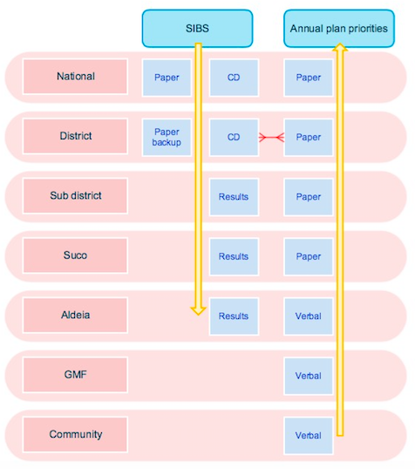
Information flow down and use
Data analysis on CDs distributed regularly
Some districts print analysis and communicate results
Some districts use data to prioritise annual plans
Performance management
District technical officer uses informal knowledge sharing from collectors to identify support

Slide 10
Data products and use
Existing data uses are limited at national and local levels
Wider potential for data use in:
Operation and Maintenance
Local planning and budgeting
Targeted capacity development
Tracking progress towards targets
Use in other sectors
Citizen and civil society groups

Slide 11
Key findings related to use
CD with vast amount of data sent regularly to each district.
Very limited knowledge of Excel, which limits use of CD.
Maps in Google Earth format and not used anywhere visited.
No formal mechanism or mandate for using data at district level, however some individuals are printing data or maps for:
Discussing results with community representation groups
Prioritising service extension plans
Opportunity to link SIBS data with other sector tools for wider use
Implementing partners do not access the data from districts and go directly to communities

Slide 12
Current limitations of the monitoring system and its operation
No linking with operation and maintenance
No verification, quality control or triangulation with other datasets
No training for interpreting results and using data
No mechanism for training new recruits
No mechanisms for community engagement
Communicating results to civil society and citizens
Database not web based and only available in DGAS national office
No formal sharing with other Ministries

Slide 13
Insights and valuable lessons for others
Combination of mobile AND paper reporting has resulted in regular data flows which can be validated and verified
Making data widely available has led to great use, scrutiny of information, and value of the data by government
Simplicity of tools and processes has reduced need for large capacity development programmes or upskilling, which has led to wide success and may have reduced turnover
Since data collection is institutionalised within permanent positions there are very few costs related with operating the system

Slide 15
Moving forwards
Graphic to show adding SIBS to a broader and more comprehensive package – SIBS as an umbrella for other aspects of monitorng WASH
SIBS
PTS

