Slide 1
Evaluating Training and Learning interventions

Slide 2
Definition and Scope of this Evaluation
What are Training and Learning Standards?
The Training and Learning Standards are statements that define the generally accepted practice to ensure quality of training and learning activities.
Why Standards?
The Training and Learning Standards serve as guide for planning, developing, implementing, and evaluating training programs of many types. The standards outline the elements that effective training and learning programs should include and serve as a foundation upon which curricula and programs should be developed, supported, and evaluated.

Slide 3
Who needs, uses Standards?
Improve program
implementation…
Basis for planning,
implementing and
evaluating training
programs
Inform and
improve future
programs
Inform stakeholders
Managers
Consultants
M&E Specialists
Donors
Governments
Technocrats
Donors
Governments
Local Gov’t Authorities
Communities
Beneficiaries

Slide 4
Relevance of the Training to the project
Project Goal:

Slide 5
Contract Goal & Objectives
Specific Goal of the training:
Specific outputs (deliverables):
Specific outcome of the training:

Slide 6
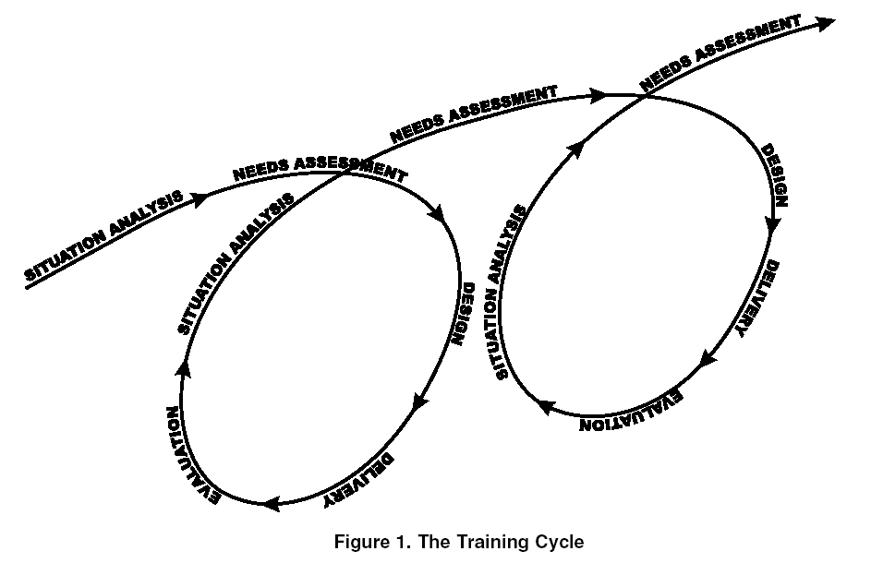

Slide 7
Instruction:
Answer ‘Yes’, ‘Not Quite’ (NQ) or ‘No’ according to your personal honest opinion about how you think this training has met the set standard or otherwise...

Slide 8
Area 1: Planning training intervention
Standard | Yes | NQ | No
1. A performance gap or gaps, (learning needs) for which the training intervention is to be developed, is/are identified.
2. A learning goal is written that addresses the gap(s).
3. Best information available is used for analysis.
4. Stakeholders are identified and involved.
5. Resources, adequate to meet the learning goal and address performance gap(s), are identified.
6. A written budget is developed
7. Information about learner characteristics and work environment is gathered and used.
8. Information about job responsibilities and essential skills and knowledge is gathered and used.

Slide 9
Area 2: Developing curricula and materials
Standard | Yes | NQ | No
9. Learning objectives are based on the essential skills, knowledge, and attitudes. Learning objectives include performance, conditions, and criteria.
10. An instructional strategy is written which outlines the following elements and ties specific elements of training to the objectives: Program description Learning goals and learning objectives Selection criteria for learners Training and learning methods Learning materials Evaluation methods Course duration Suggested course composition (number of learners, trainers, etc.) Training implementation, follow-up and evaluation plans.
11. Curriculum and supporting materials are related to learning needs and requirements and match the instructional strategy.
12. Stakeholders are involved to ensure transfer of learning.
13. Copyright, acknowledgements, and logo use meet requirements.

Slide 10
Area 3: Preparing for implementation
Standard | Yes | NQ | No
14. Logistical arrangements for the intervention are made in advance, including needed accommodations for trainers and/or learners with disabilities.
15. Learning resources (printed materials, models, audio-visual equipment, training packages, etc.) are ready for use.
16. A plan for trainer and facilitator selection and preparation is in place.
17. Mechanisms are in place to support the transfer of learning.
18. For clinical trainings, adequate caseload, site preparation, preceptors, and trainers are scheduled and arranged. | n/a | n/a | n/a

Slide 11
Area 4: Implementing training
Standard | Yes | NQ | No
19. Learning resources, equipment and supplies are available and used for intended purposes.
20. Logistical arrangements meet trainers’ and learners’ needs.
21. Technology required to implement learning intervention is available.
22. Learning intervention requires active engagement on the part of trainers and learners. Is/was this the case?
23. Both knowledge and skills are assessed as planned in the instructional strategy.
24. Skills acquisition is competency-based.
25. All individuals involved in training (trainers and learners) receive feedback.

Slide 12
Area 5: Following up learners
Standard | Yes | NQ | No
26. A written follow-up plan is in place.
27. Mechanisms for follow-up are integrated in the supervision system.
28. Learners develop action plans for applying learning on the job.
29. Up-to-date information and resources to support job performance are given.

Slide 13
Area 6. Evaluating for effectiveness
Standard | Yes | NQ | No
30. A written evaluation plan is in place and describes what will be evaluated, how and where, when, who, and resources needed.
31. Evaluation shows how the learning intervention has affected learners’ performance.
32. Evaluation reports reflect program results that can be used for decision-making.

Slide 14
Area 7. Documenting Lessons Learned
Standard | Yes | NQ | No
33. A system is used to document and manage information about this training intervention’s learners, trainers, learning resources, logistical resources, and training activities.

Slide 15
Thank you
Paul L. Mendy
Monitoring & Evaluation Specialist
AfDB funded P2RS Building Resilience Project
IFAD funded Nema Land & Water Dev. Mgmt Project
IsDB funded Building Resilience Project
Tel: +220 3535483 / 9267250
Email: mendy.paull@gmail.com

